Slide 1
Chapter 8 Regression Trees and Rule-Based Models
By Kayla X
6/22/2020

Slide 2
A rule is a set of if-then conditions(possibly created by a tree) that have been collapsed into independent conditions. For example, there would be three rules:
if Predictor A >= 1.7 and Predictor B >= 202.1 then Outcome = 1.3
if Predictor A >= 1.7 and Predictor B < 202.1 then Outcome = 5.6
if Predictor A < 1.7 then Outcome = 2.5
Rules can be simplified or pruned in a way that samples are covered by multiple rules.

Slide 3
Tree-based and rule-based models are popular modeling tools
Can effectively handle many types of predictors (sparse, skewed, continuous, categorical, etc.) without preprocessing
Do not require the user to specify the form of the predictors’ relationship to the response like, for example, a linear regression model requires.
can effectively handle missing data and implicitly conduct feature selection

Slide 4
Tree-based and rule-based models Weaknesses
Model instability (i.e., slight changes in the data can drastically change the structure of the tree or rules and, hence, the interpretation)
Less-than-optimal predictive performance

Slide 5

8.1 Basic Regression Trees
regression trees determine:
• The predictor to split on and value of the split
• The depth or complexity of the tree
• The prediction equation in the terminal nodes
Notes:
For regression, the model begins with
the entire data set, S, and searches every distinct value of every predictor
to find the predictor and split value that partitions the data into two groups
(S1 and S2)
where ¯y1 and ¯y2 are the averages of the training set outcomes within groups
S1 and S2, respectively. Then within each of groups S1 and S2, this method
searches for the predictor and split value that best reduces SSE. The process continues within the set of S! and S2 unitl the number of samples in the splits falls below some threshold(tree growing step)

Slide 6

Model can be turned by using Cost-Complexity tuning
goal is to find right sized tree, that has smallest error rate
Can also handle missing data
predictors that appear higher in the tree (i.e. earlier splits) or those that appear multiple times in the tree will be more important than predictors that occur lower in the tree or not at all.
or using the one-standard-error rule on the optimization criteria for identifying the simplest tree: find the smallest tree that is within one standard error of the tree with smallest absolute error
Notes:
Cp is called complexity parameter. For a specific value of the
complexity parameter, we find the smallest pruned tree that has the lowest
penalized error rate.

Slide 7
Disadvantages of Trees
First, single regression trees are more likely to have sub-optimal predictive performance compared to other modeling approaches. This is partly due to the simplicity of the model.
Individual tree tends to be unstable
Selection bias-predictors with a higher number of distinct values are favored over more granular predictors

Slide 8
Unbiased regression tree techniques
generalized, unbiased, interaction detection and estimation (GUIDE) algorithm
conditional inference trees-test statistic p-value

Slide 9
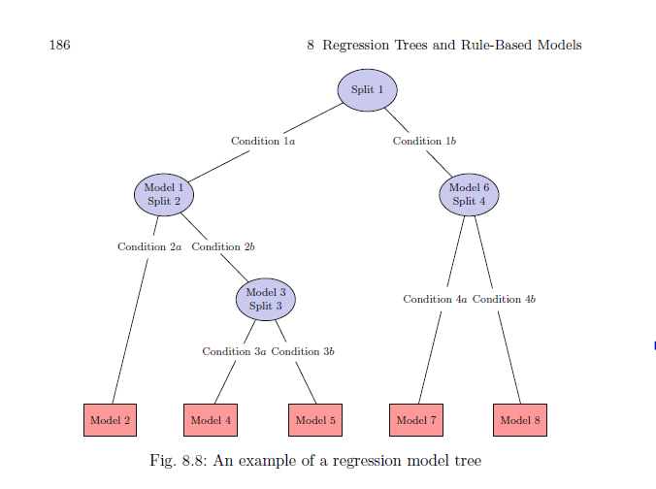
8.2 Regression Model Trees
model tree with four splits and eight linear regression models. Model 5, for instance, would be created using all the predictors that were in splits 1–3 and with the training set data point satisfying conditions 1a, 2b, and 3b
Each model computes adjusted error rate and also incorporate smoothing and decrease over-fitting
For example, For our example, the new sample falling under conditions 1a, 2b, and 3b would use a combination of three linear models.

Slide 10
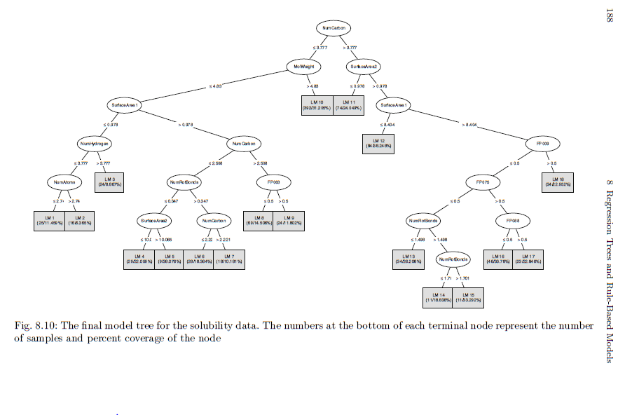
8.3 Rule-Based Models
A rule is defined as a distinct path through a tree. Consider the model tree
shown in the last section and the path to get to linear model 15 in the chart
NumCarbon > 3.777 &
SurfaceArea2 > 0.978 &
SurfaceArea1 > 8.404 &
FP009 <= 0.5 &
FP075 <= 0.5 &
NumRotBonds > 1.498 &
NumRotBonds > 1.701

Slide 11
Ways to simplifying the rules from classification trees
Cubist model
Separate and conquer strategy
After initial model tree is created, only the largest coverageis saved from the model
Another tree will be created using remaining data
Process repeats until all the training set data have been covered by at least one rule

Slide 12
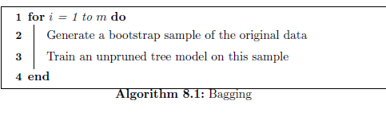
8.4 Bagged Trees
Reducing variance
Bootstrap-Artificially create multiple training sets from single data set
Take repeated samples from the single training data set, allow same sample more than once.
Each resampled training set , fit the decision tree and get some predictions
Average all of the predictions

Slide 13
Out-of-bag Error Estimation
Bootstrap for each model, where is left out is called out of bag observation
Average of out of bag performance used to assess the predictive performance of the model
Error estimate-out of bag estimate samples that were incorrectly classified is the ‘out-of-bag error’

Slide 14
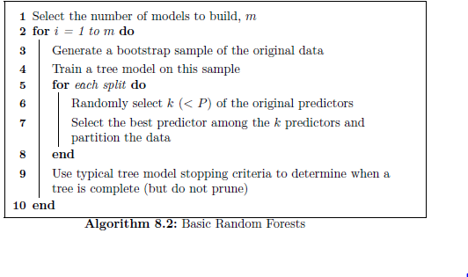
8.5 Random Forests
Created a decision tree using the bootstrapped dataset, but only use a random subset of variables at each step
Using out-of-bag to measure how accurate random forest is
Changing number of variables used per step and then choose the one that most accurate
The variety makes random forests more effective than individual decision trees

Slide 15
8.6 Boosting-Adaboost(adaptive)
Bossting algorithms –add-on to the bagging idea where in subsequent bags we choose those data instances that had been modeled poorly in the overall system before.
Another way to say is converting weak learners into strong learners. A weak learner is one which is slightly better than random guessing.
Bossting is a s sequential process. Tress are grown using the information from a previously grown tree one after another. By giving more weight to the misclassified points and creates next classifier
Gradient boost
given a loss function (e.g., squared error for regression) and a weak learner (e.g., regression trees), the algorithm seeks to find an additive model that minimizes the loss function. The algorithm is typically initialized with the best guess of the response (e.g., the mean of the response in regression). The gradient (e.g., residual) is calculated, and a model is then fit to the residuals to minimize the loss function.

Slide 16
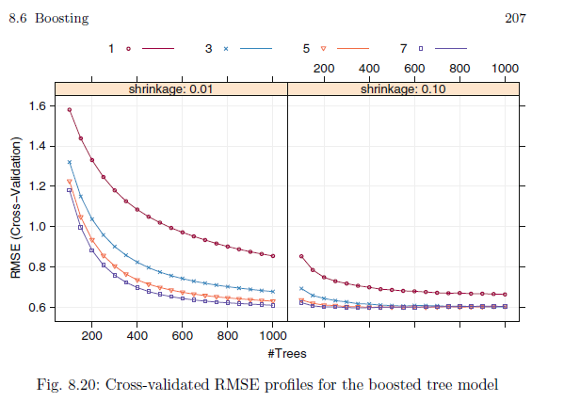
The optimal boosted tree has depth 3 with 400 trees and shrinkage of 0.1. These settings produce a cross-validated RMSE of 0.616.

Slide 17
8.7 Cubist
Cubist is a prediction-oriented regression model that combines the ideas in Quinlan (1992) and Quinlan (1993a)(additional corrections based on nearest neighbors in the training set).
The specific techniques used for linear model smoothing, creating rules, and pruning are different
An optional boosting—like procedure called committees
The predictions generated by the model rules can be adjusted using nearby points from the training set data

Slide 18
Although it initially creates a tree structure, it collapses each path through the tree into a rule. A regression model is fit for each rule based on the data subset defined by the rules. The set of rules are pruned or possibly combined. and the candidate variables for the linear regression models are the predictors that were used in the parts of the rule that were pruned away. This part of the algorithm is consistent with the "M5" or Model Tree approach.

